Slide 1
Week-08 Web Application Architecture
Course Instructors:
Mr. HARIS AHMED
DEPARTMENT OF SOFTWARE ENGINEERING
SIR SYED UNIVERSITY OF ENGINEERING & TECHNOLOGY

Slide 2
Agenda
Software Architecture
Web Application Architecture: Importance, Working
Layers of Web App Architecture
Web Application Components, Models
Types of Web Application Architecture
Web Application Architecture: Best Practices

Slide 3
Software Architectures
“Architecture is defined as the fundamental organization of a system, embodied in its components, their relationships to each other and the environment, and the principles governing its design and evolution.”(IEEE Architecture Working Group, P1471, 1999)
Architectures describe structure
-Components of software systems, their interfaces and relationships
-static as well as dynamic aspects
-blueprint of software system
Architectures connect software development phases
-requirements mapped iteratively to components and their relationships.
Notes:
Software architecture is, simply, the organization of a system. This organization includes all components, how they interact with each other, the environment in which they operate, and the principles used to design the software.

Slide 4
Software Architecture
Architectures describe different viewpoints
– conceptual view: entities of application domain and their relationships (Customer, Order, Product)
– process view: system runs, concurrency, synchronization (Multiple users )
– implementation view: software artefacts (subsystems, components, source code)
– runtime view: components at runtime and their communication
Architectures make systems comprehensible and controllable
– structuring according to different viewpoints
– enables communication between different stakeholders

Slide 5
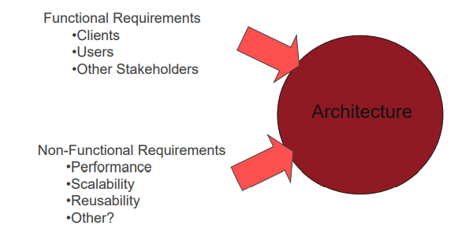
Developing Architectures Influences on Architectures

Slide 6
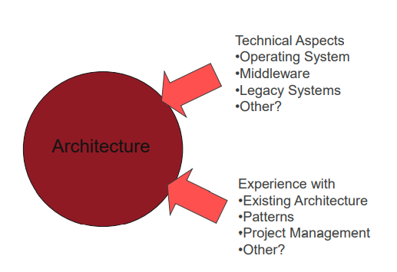
Developing Architectures Influences on Architectures

Slide 7
Developing Architectures
Remember, requirements are always subject to change.
– Organizational & Environment changes
– Ambiguous requirements initially
Thus, iterative approaches are the suggested means of development
– Pro: Helps to mitigate design risks
– Caution: Doesn’t guarantee a good architecture (ex., What about legacy systems?)
Notes:
In computing, a legacy system is an old method, technology, computer system, or application program, "of, relating to, or being a previous or outdated computer system," yet still in use.

Slide 8
WEB APPLICATION ARCHITECTURE
Web application architecture is a blueprint of simultaneous interactions between components, databases, middleware systems, user interfaces, and servers in an application.
It can also be described as the layout that logically defines the connection between the server and client-side for a better web experience.
Notes:
Middleware is software that bridges gaps between other applications, tools, and databases in order to provide unified services to users.

Slide 9
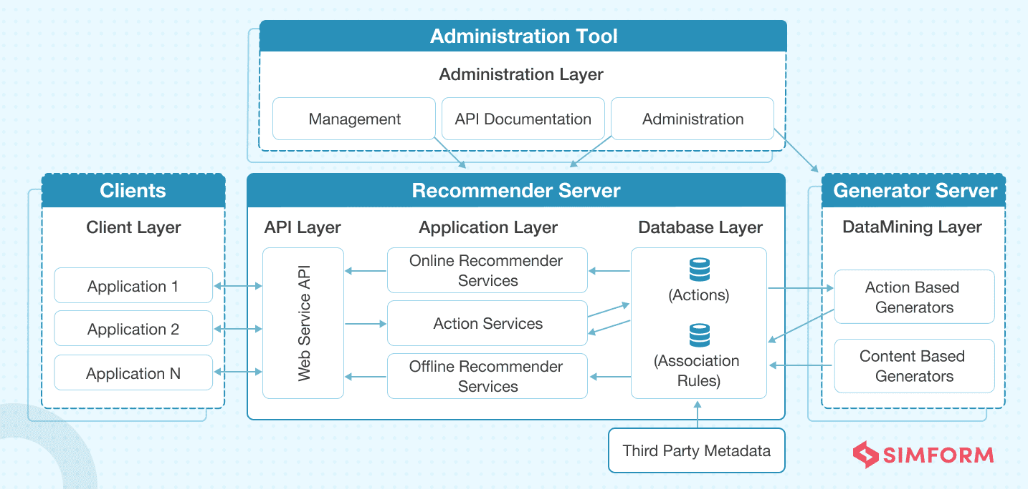
WEB APPLICATION ARCHITECTURE

Slide 10
Why is Web App Architecture Important?
Market trends keep changing, user expectations keep evolving, and the growth of a business is never-ending.
A well-thought web app architecture can handle the various loads and adapt to the changing business requirement skillfully to deliver a fast user experience that further improves the app performance.
You can also take on several development tasks at the same time by dividing the structure into several small modules, eventually reducing the development time as well.
Furthermore, it becomes easier to integrate new functionalities without affecting the overall structure.
web architecture divides the application into several blocks that are secured separately to minimize security threats, including the risk posed by malicious codes.
Apart from that, applications with a future-proof architecture provide the opportunity to add new features and maintain low latency, even when user count increases.

Slide 11
How does the Web App Architecture Work?
All applications are made up of two primary components:
Client-side, popularly called: the frontend, where the code is written in HTML, CSS, JavaScript and stored within the browser. It’s where user interaction takes place.
Server-side, also known as the backend, controls the business logic and responds to HTTP requests. The server-side code is written in Java, PHP, Ruby, Python, etc.
Apart from this, there is an additional component i.e. database server, which sends the requested data to the server-side.

Slide 12
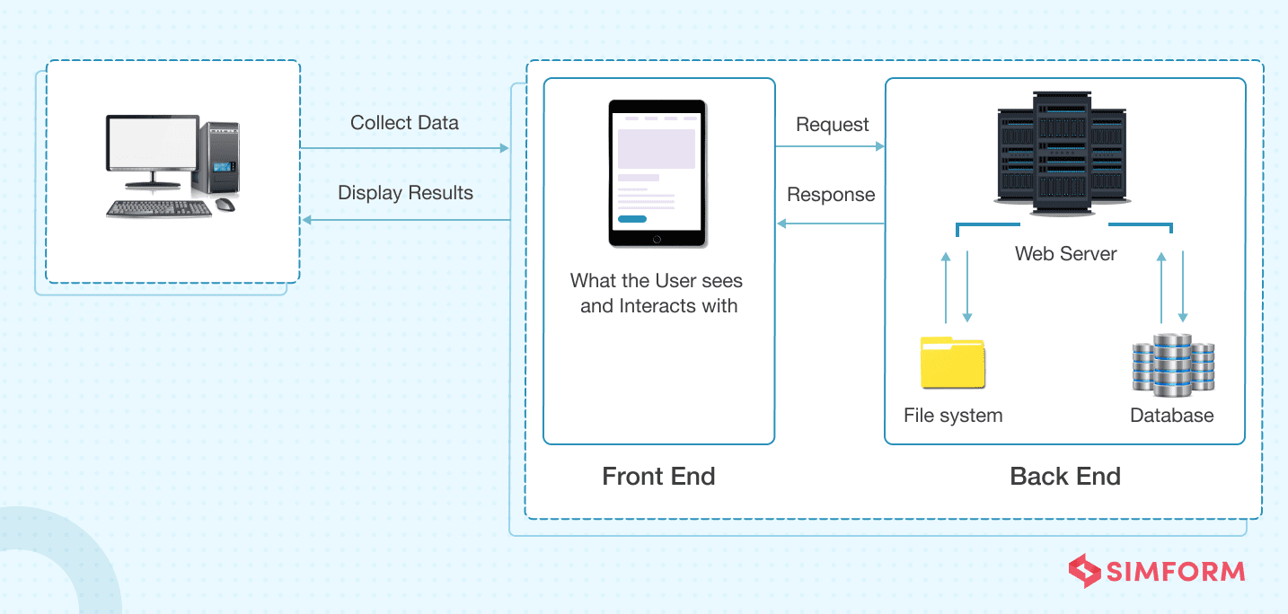
Contd…
Let’s understand how an architecture functions:
You type a URL, for example, ‘walmart.com’ in the browser and hit enter. The browser will send a request to the Domain Name Server that will recognize the IP address and further send your request to the server where Walmart is located. The server then catches the request and sends it to the data storage to locate the page and requests for data to be displayed on the browser. The page is then displayed on your screen with the requested information.

Slide 13
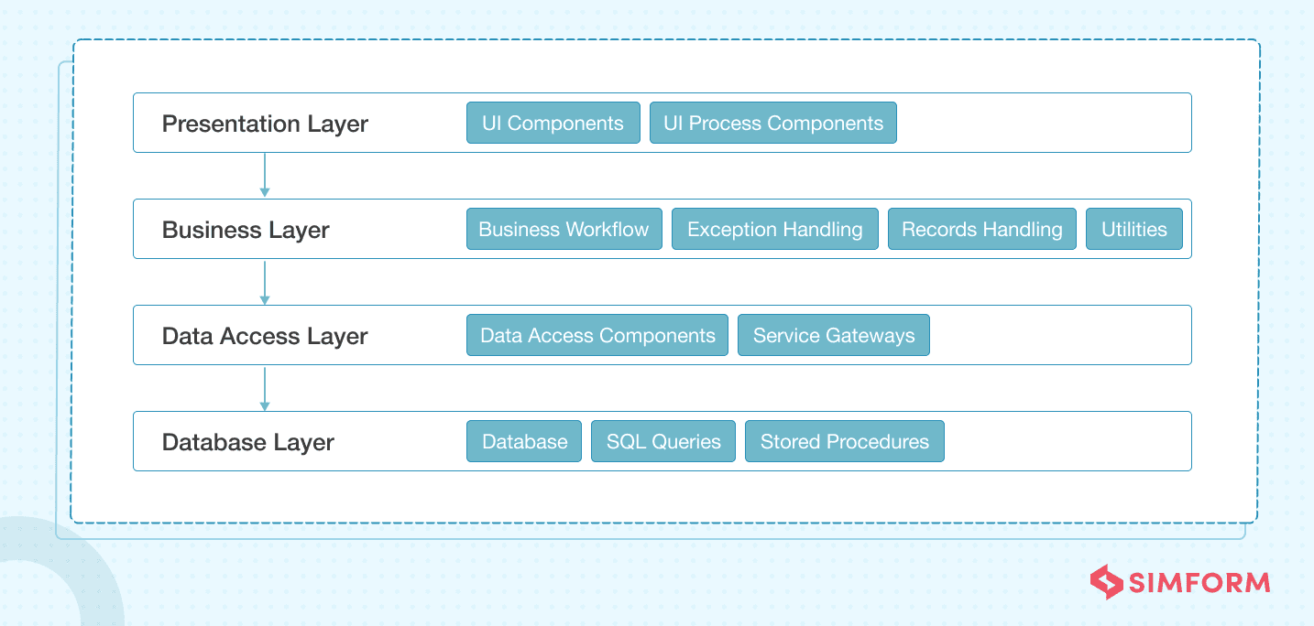
Layers of Web App Architecture
Modern web applications follow a layered architecture that consists of presentation, business, Data access, and database layers. Small applications have three layers, where, in some cases, the business and persistence layers act as one layer, while complex applications have five or six layers.

Slide 14
Layers of Web App Architecture
Presentation layer, built with HTML, CSS, JavaScript, and its frameworks, enables communication between the interface and browser to facilitate user interaction.
Business layer defines the business logic and rules. It processes browser requests, executes the business logic associated with the requests, and then sends it to the presentation layer.
Persistence layer is responsible for data persistence and is also known as Data Access Layer. It’s closely connected to the business layer and has a database server that retrieves data from corresponding servers.(history client)
Database layer, also known as Data Service Layer, holds all the data and ensures data security by separating the business logic from the client-side.
Notes:
The business layer, also called the domain layer, is where the application's business logic operates. Business logic is a collection of rules that tell the system how to run an application, based on the organization's guidelines. This layer essentially determines the behavior of the entire application. After one action finishes, it tells the application what to do next.
The persistence layer, also called the data access layer, acts as a protective layer. It contains the code that's necessary to access the database layer.

Slide 15
CONTD…
Each of these layers works in isolation. That means each layer works independently. Components of one layer are closed and deal with the associated layer’s logics. For example, components residing in the presentation layer deal with presentation logic, while the components in the business layer deal with business logic.
It also reduces the future burden while changes are required in the web application. Hence, changes can be made in one layer without affecting the components of other layers.

Slide 16
Web Application Components
Web app components are broadly divided into two parts–
User interface components are a part of the visual interface of a web application and have no interaction with the architecture. They’re restricted to a web page’s display and consist of activity logs, configuration settings, dashboards, statistics, widgets, notifications, etc., to enhance the user experience.
Structural web components consist of client and server components. Client components exist in the user’s browser and interact with the functionality of web applications. HTML, CSS, and JavaScript are commonly used for building these components.(Facebook feed)
On the other side, server components are bifurcated into a web app server that handles business logic and a database server that stores data. PHP, JAVA, Python, Node.js, .NET, and Ruby on Rails are some frameworks used for creating server components.

Slide 17
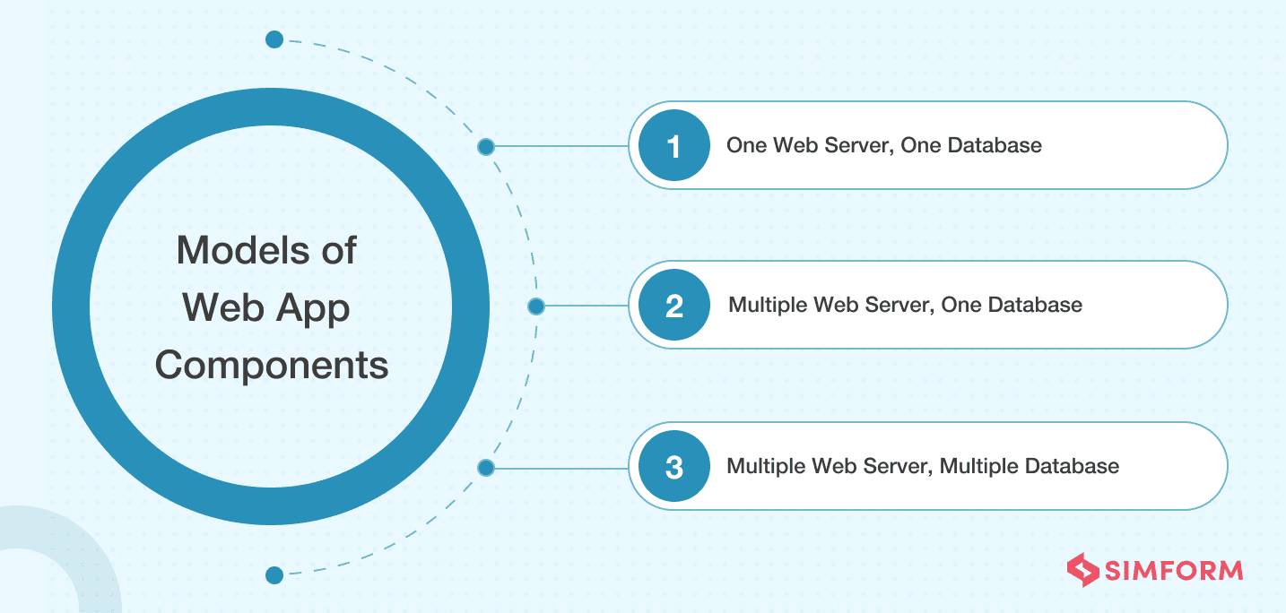
Models of Web Applications Components
There are several models used to build these aforementioned components.

Slide 18
CONTD…
One web server, one database model might be a little outdated as it has only one server and database to handle all requests. This means if the server goes down so will your app. However, it is generally used for test practices and is a good option if you are a startup having budgetary constraints.
Multiple web servers, one database model reduces the risk of data failure as a backup server is always available if one server goes down. However, the chances of the website crash may still exist due to the availability of only one database.
Multiple web servers, multiple databases model reduces the app’s performance risk since there are two options for database storage. You can either store identical data on all the databases or distribute it evenly among all servers.

Slide 19
Types of Web Application Architecture
It is always a good practice to select the most appropriate architecture considering various factors in mind, such as app logic, features, functionalities, business requirements, etc. The right architecture defines the purpose of your product as a whole.
Web applications are broadly divided into following types:
Single Page Application Architecture
Microservice Architecture
Serverless Architecture

Slide 20
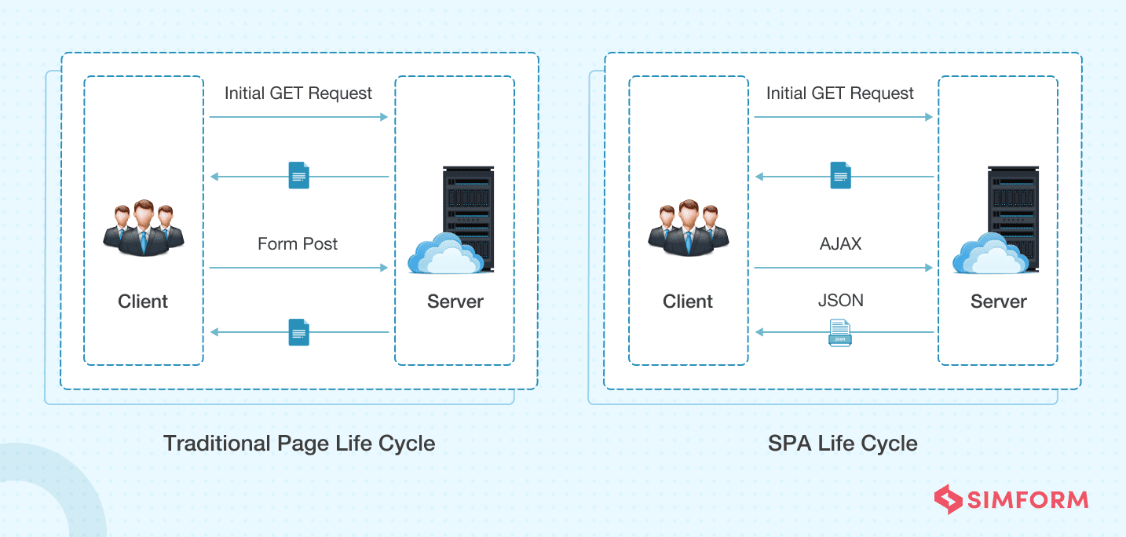
Single Page Application Architecture
SPA (Single Page Applications) has been introduced to overcome the traditional limitations to achieve smooth app performance, intuitive, and interactive user experience.
Instead of loading a new page, SPAs load a single web page and reload the requested data on the same page with dynamically updated content. The rest of the web page remains untouched. They are developed on the client-side using JavaScript frameworks as the entire logic is always shifted to the frontend.

Slide 21
Microservice Architecture
These are small and lightweight services that execute a single functionality. The Microservices Architecture framework has a number of advantages that allows developers to not only enhance productivity but also speed up the entire deployment process.
The services are loosely coupled to be developed, tested, maintained, and deployed independently.
Such services can also communicate with other services through APIs to solve complex business problems.
The components making up an application build using the Microservices Architecture aren’t directly dependent on each other. As such, they don’t necessitate to be built using the same programming language. Hence, developers working with the Microservices Architecture are free to pick up a technology stack of choice. It makes developing the application simpler and quicker.

Slide 22
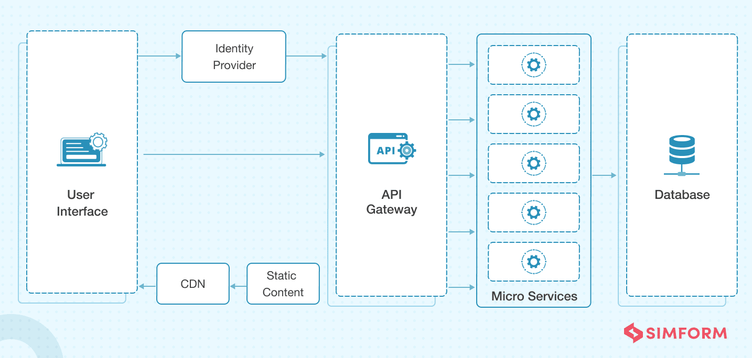
Contd…
Deployment of web apps using monolithic architecture is a cumbersome task because of its tightly coupled components. Microservices has resolved this issue by separating the application into multiple individual service components.
Some tech giants who are popular for using microservices are Amazon, Netflix, SoundCloud, Comcast, and eBay.
Notes:
Monolithic software is designed to be self-contained, wherein the program's components or functions are tightly coupled rather than loosely coupled,
in a monolithic architecture, each component and its associated components must all be present for code to be executed or compiled and for the software to run.
Monolithic applications are single-tiered, which means multiple components are combined into one large application.
Furthermore, if one program component must be updated, other elements may also require rewriting, and the whole application has to be recompiled and tested.

Slide 23
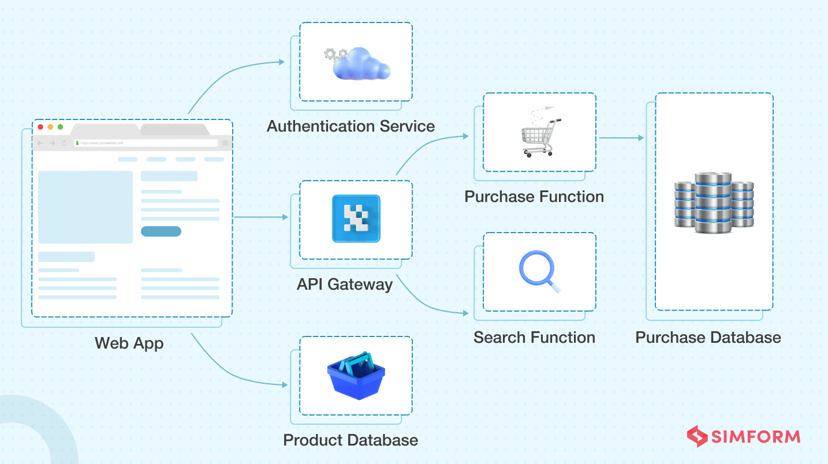
Serverless Architecture
It’s an architecture where the whole execution of code is taken care of by cloud service providers– no need to deploy them manually on your server. Serverless architecture is a design pattern where applications are built and run without any manual intervention on the servers that are managed by third-party cloud service providers like Amazon and Microsoft.

Slide 24
CONTD…
It lets you focus more on the quality of the product and complexity to make them highly scalable and reliable.
Broadly, it is categorized into two types – Backend-as-a-Service (BaaS) and Function-as-a-Service (FaaS).
BaaS lets developers focus on the frontend development tasks, eliminating the operations performed on the backend. AWS Amplify, for one, is a popular BaaS product.
FaaS, on the other hand, is an event-driven model that allows developers to break the applications into small functions to focus on the code and event triggers. The rest will be handled by the FaaS service providers such as AWS Lambda and Microsoft Azure.

Slide 25
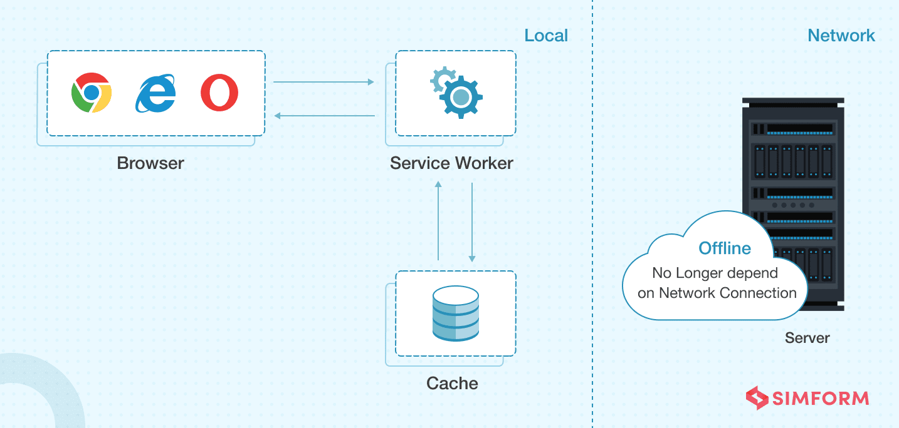
Progressive Web Applications
Google introduced Progressive Web Apps (PWAs) in 2015 to develop apps that offer rich and native functionality with enhanced capabilities, reliability, and easy installation.

Slide 26
CONTD…
PWAs are compatible apps with any browser and can run on any device. You can easily adjust an app’s function to a tablet and a desktop as well.
These apps can easily be discovered and shared through URL instead of the app store.
Installation of these apps is also effortless and can be quickly added to a device’s home screen.
These apps work efficiently on poor internet connectivity and in offline mode as well.
Uber, Aliexpress, Alibaba, Pinterest, and Starbucks are few famous companies who are known for developing their products in the form of PWAs.

Slide 27
Web Application Architecture: Best Practices
Designing an architecture is just the first step, but the success of your web application depends a lot on the architectural patterns you choose. Replicating strategies of popular web apps can do more damage than good, for oftentimes they don’t complement your business requirements. To avoid such circumstances, there are few best practices you can follow.
Ensure that your web app’s architecture has:
System flexibility and efficiency
Component reusability
Well-thought structure of code
High Scalability
Stability and reliability
Easy bug-detection through A/B testing
Utilization of security standards
Sections to collect user feedback

Slide 28
Summary
The success of a modern web application is always closely connected to its architecture— more precise web application architecture — more rapid and secure web-based communication for users. Keeping pace with changing requirements is a challenging task and a minor mistake can cost you the life of your product.
The robustness, responsiveness, security, etc. of a web application is greatly determined by the model and type of web application architecture one chooses. Hence, before getting started with the development, take time to explore all requirements, goals, and possibilities.

Slide 29
Bibliography
Web Application Architectures- Book Chapter#04
https://www.simform.com/blog/web-application-architecture/
https://hackr.io/blog/web-application-architecture-definition-models-types-and-more

